Slide 1
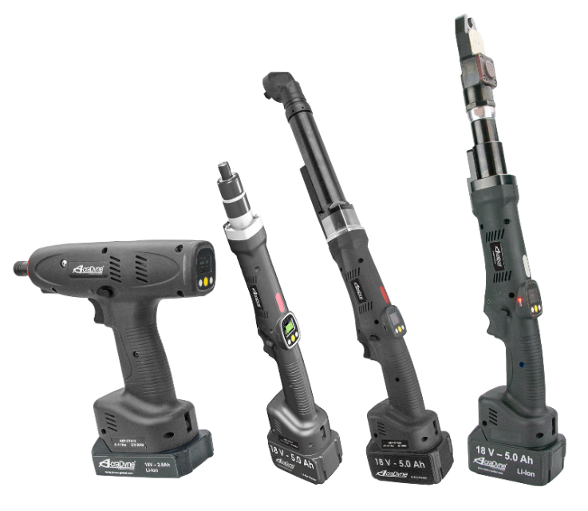
High-Performance Cordless AB Series
Recover Your Tool
using AcraDyne Tool Manager Software
10000 SE Pine St., Portland, OR 97216 • (503) 254-6600 • (800) 852-1368 • www.aimco-global.com

Slide 2
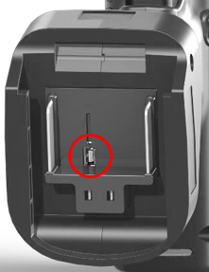
Recovery
In order to start tool recovery, connect the tool your PC using the USB cable.

Slide 3
Recovery
Make sure you have the latest version of AcraDyne Tool Manager software. The software is available on the AIMCO website.
Any new release is backward-compatible. Please delete old versions of the software.
Log on as Administrator.
Admin

Slide 4
Recovery
Click on the USB icon.

Slide 5
Recovery
When the tool connects successfully, you will see “connected” on the lower left of the screen.

Slide 6
Recovery
Click on the folder icon, which is the “load saved configuration” button.

Slide 7
Recovery
Browse either for the latest tool backup file or the initial tool settings.
Click “Open.”

Slide 8
Recovery
If using a tool backup file, Tool Manager will ask if you would like to recover the tool.
Acknowledge with OK.

Slide 9
Recovery
If you are not using a backup of the tool itself, Tool Manager will ask which parts of the tool you
would like to recover.
Acknowledge with OK.

Slide 10
Recovery
Click on “write” to save the data to the tool.
The tool should be ready to use.

Slide 11
Thank You
www.aimco-global.com
10000 SE Pine St., Portland, OR 97216 • (503) 254-6600 • (800) 852-1368 • www.aimco-global.com

