Slide 1
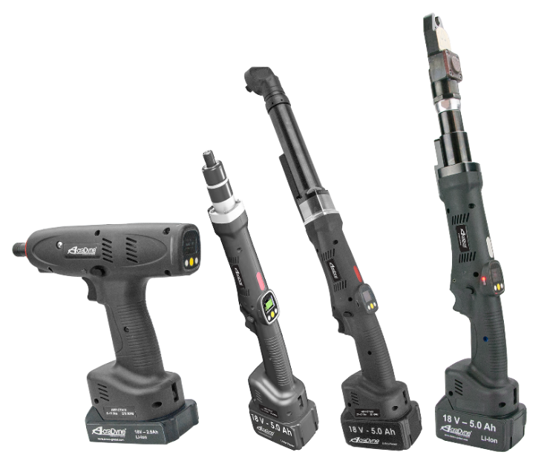
High-Performance Cordless AB Series
Save a Curve Back-up File using AcraDyne Tool Manager Software
10000 SE Pine St., Portland, OR 97216 • (503) 254-6600 • (800) 852-1368 • www.aimco-global.com

Slide 2
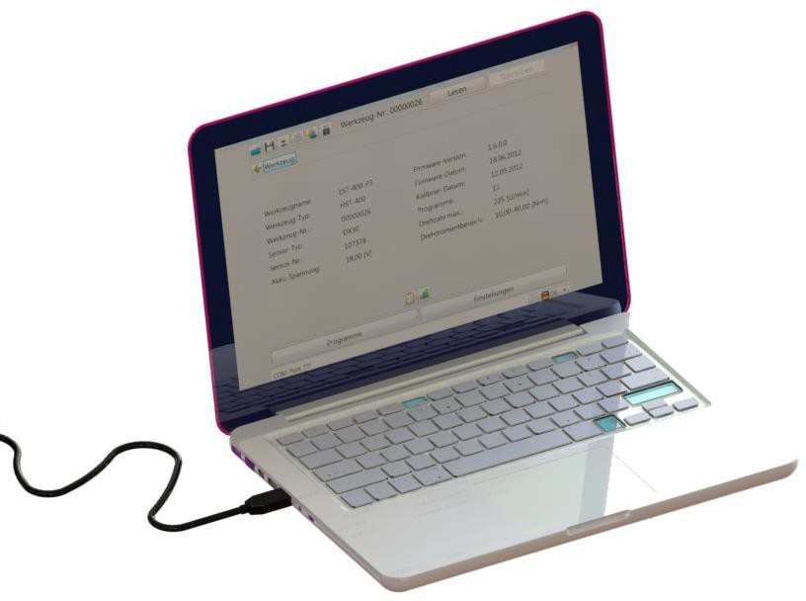
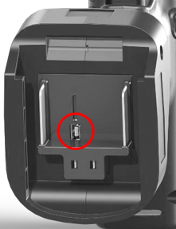

Back-up
In order to start the tool update, connect the tool to your PC using the USB cable.

Slide 3
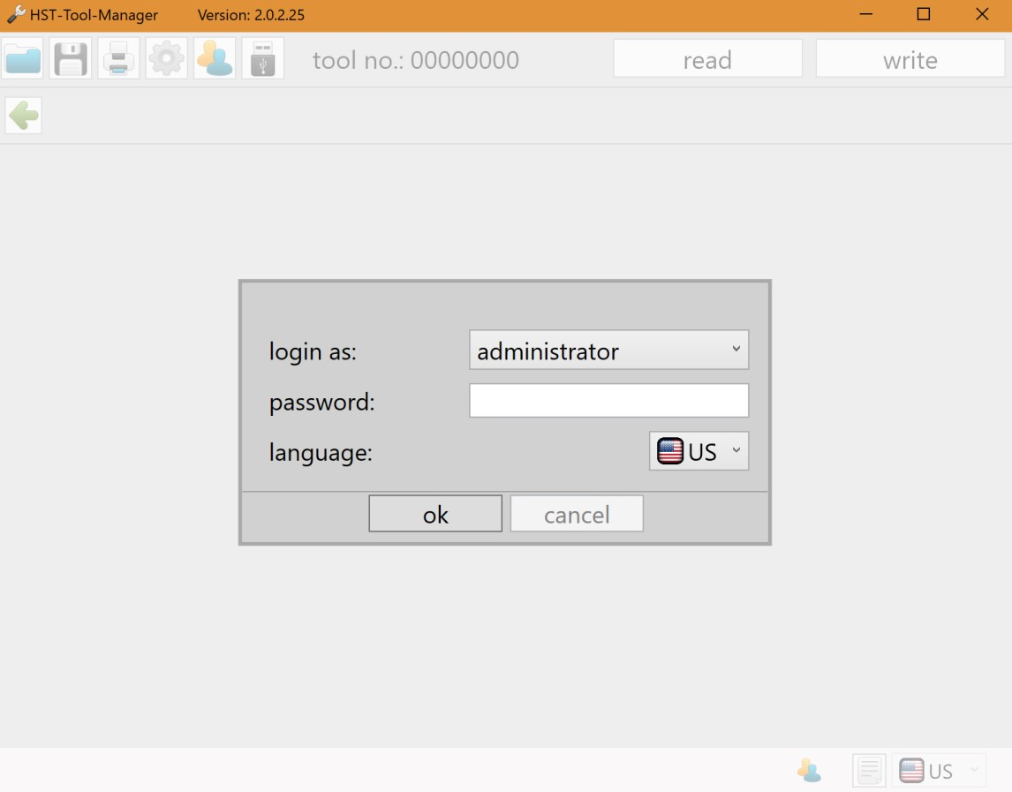
Back-up
Make sure you have the latest version of AcraDyne Tool Manager software. The software is available on the AIMCO website.
Any new release is backward-compatible. Please delete old versions of the software.
Log on as Administrator.
Admin

Slide 4
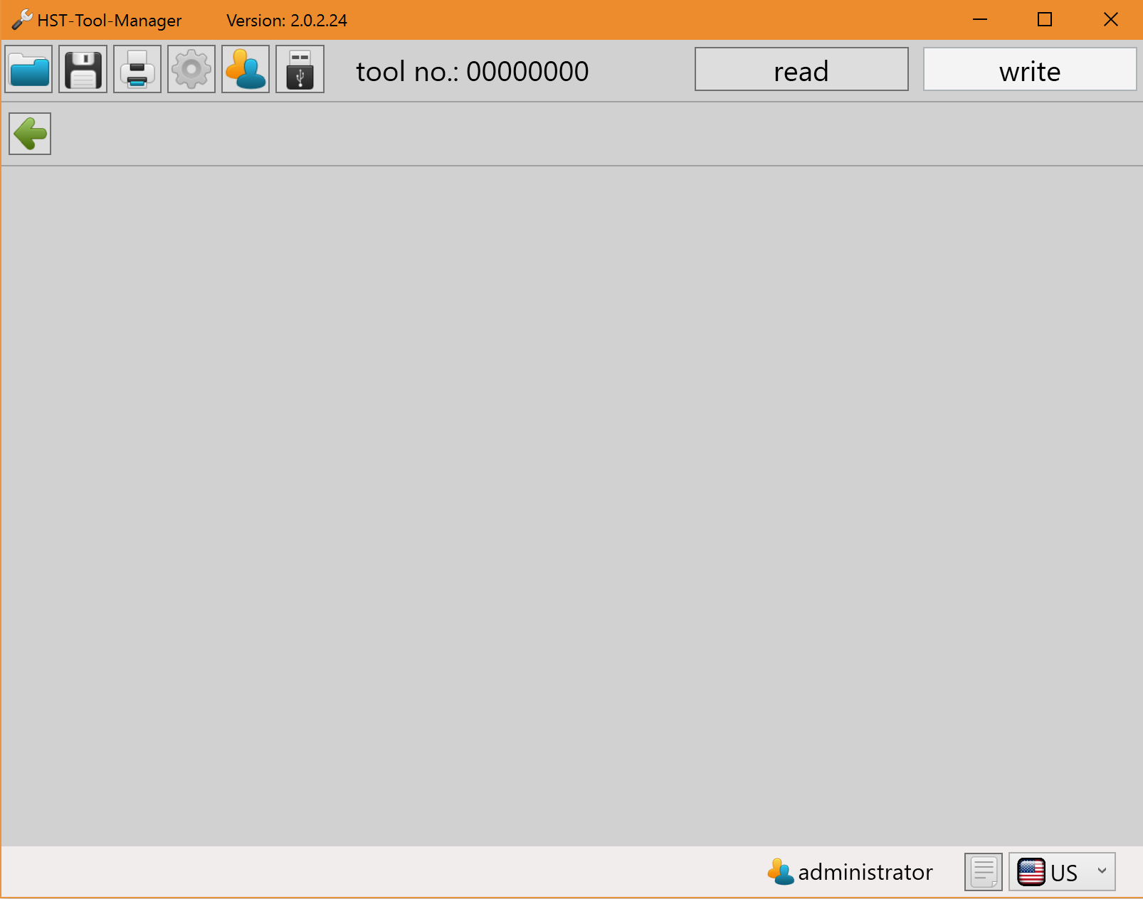
Back-up
After you log in, click “read.”

Slide 5
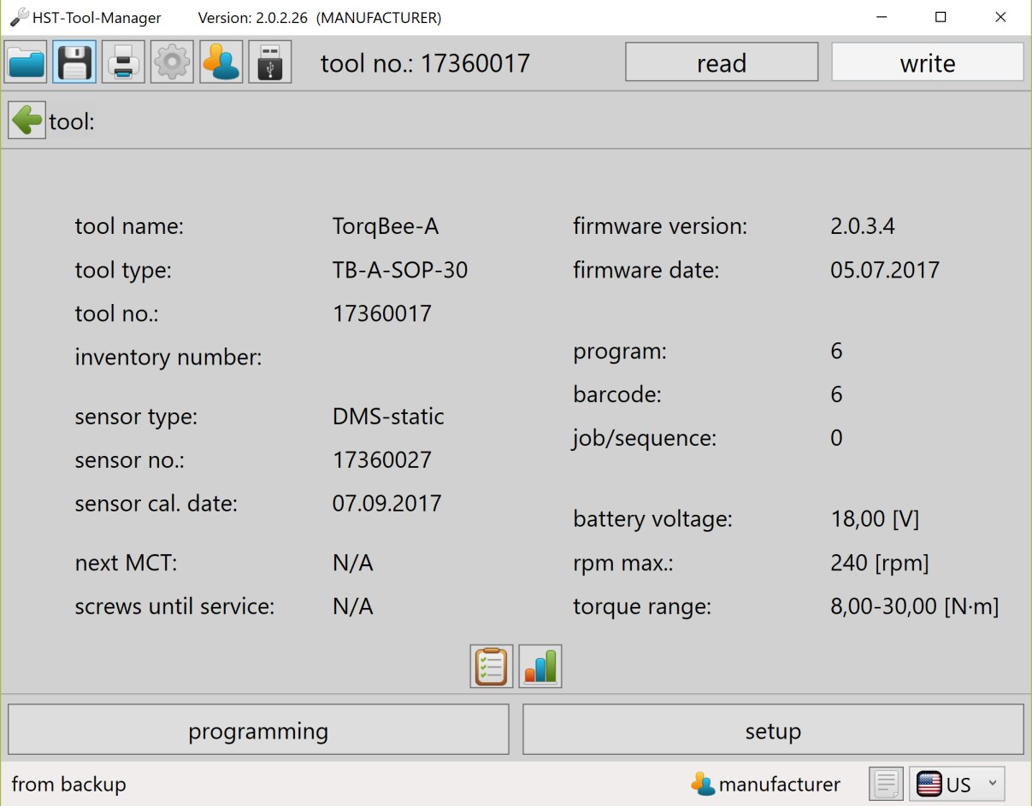
Back-up
Once the tool is read, click on the graph symbol at the bottom of the screen.

Slide 6
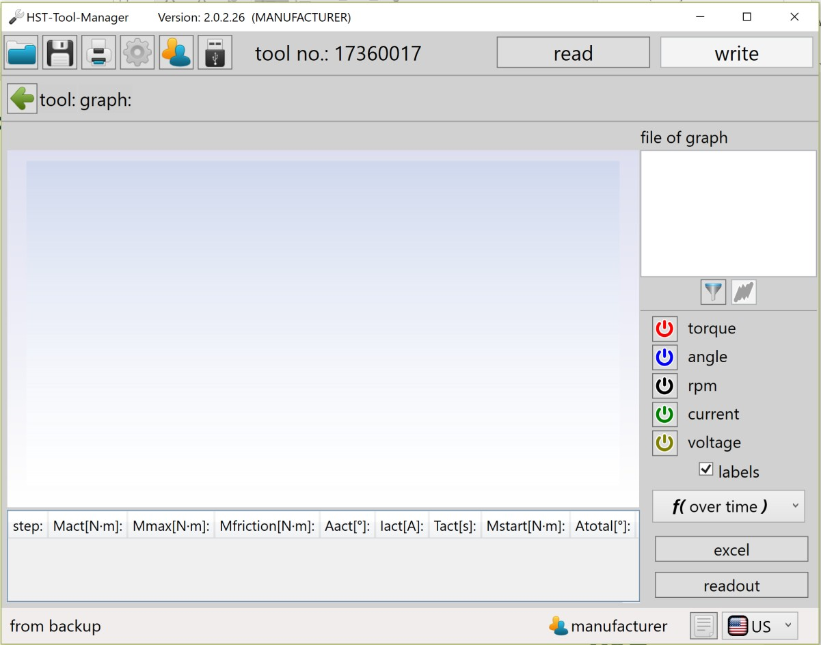
Back-up
Click "readout" to read the last 10 – 50 curves.

Slide 7
Back-up
After the curves are read, save a backup as xml.

Slide 8

Thank You
www.aimco-global.com
10000 SE Pine St., Portland, OR 97216 • (503) 254-6600 • (800) 852-1368 • www.aimco-global.com

